Slide 1

Boats Boats Boats
NWEN304 Group Project Progress Presentation
Will Burroughs, Marshall Scott, Jesper Ahlman

Slide 2
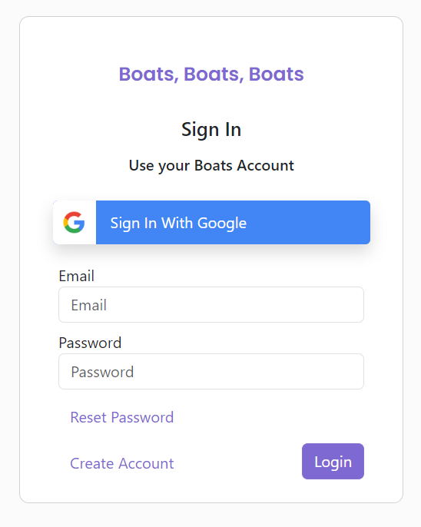
User Registration
User can register with email via /register end point, this ensures a valid email & password are entered
/product is used to query the DB to ensure unique email
If valid email & password → New User entered into DB
Using bcrypt library to hash & salt the password

Slide 3
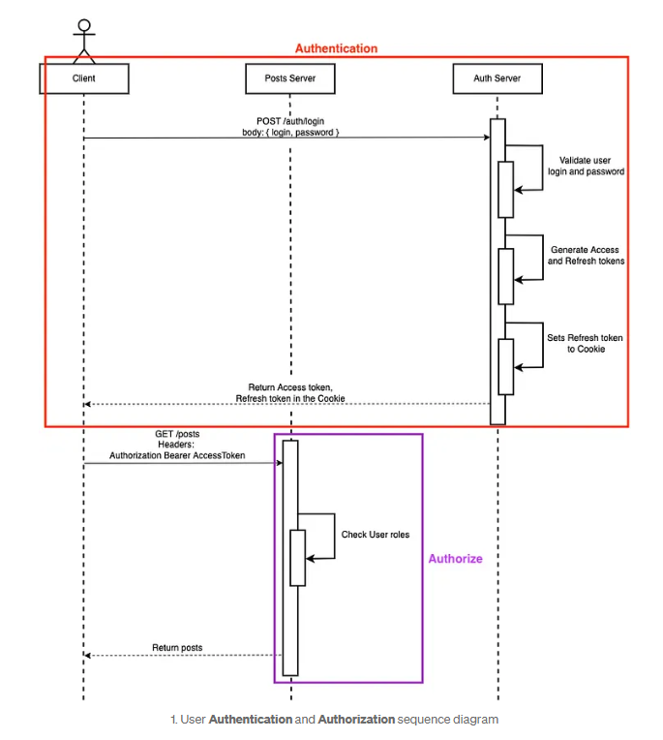
Json Web Token for User Authentication & Authorisation
Registered user is Authenticated via /auth → Assigned Access & Refresh tokens
Access Token → Allows short term access to API’s
Refresh Token → Allows for long term refreshing of Access token
verifyJWT middleware used to determine if user is Authenticated to access the specified endpoint → Do they have valid accessToken
verifyRoles middleware use to determine if user is Authoriszed to access the specified end point → Do they have the required role permissions

Slide 4
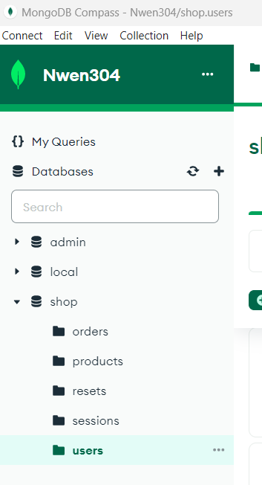
NoSQL Database
-Uses MongoDB compass
-Data stored in collections

Slide 5
Endpoints for resources
-Endpoints are created in routes folder
-Routes direct to methods in controller to apply logic
-Resources are returned using this route

Slide 6
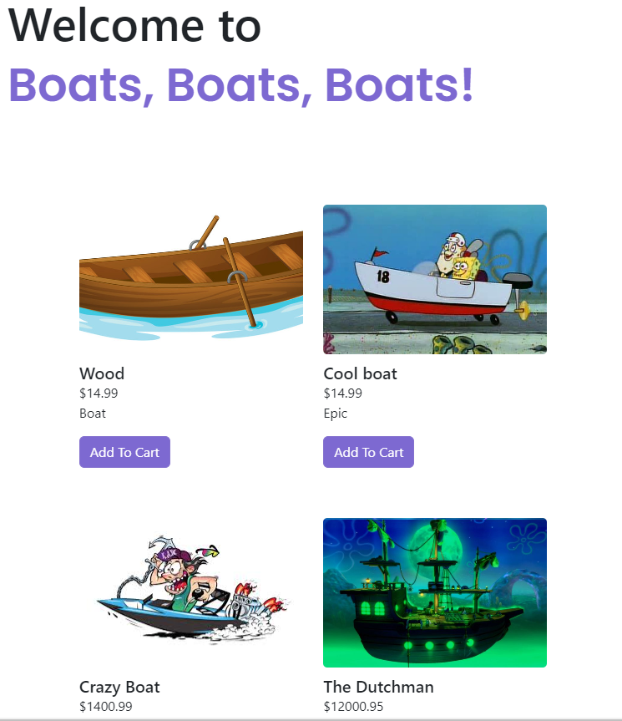
Web Rendering
Rendering of pages is done server-side using Handlebars.js.
It injects passed variables into the template such as product information, user logged in status, edit buttons for admins and cart items.
Dynamic content is rendered through client-side javascript such as loading indicators, editing products, displaying error messages, recommendation fetching.

Slide 7
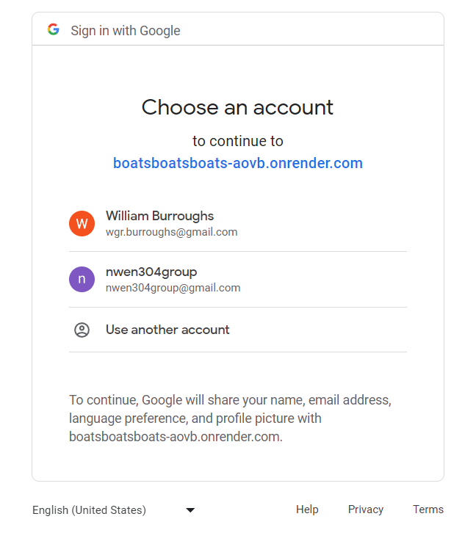
OAuth
User can sign in using Google account
Relies on GoogleAPI & Passport
Handles users that are already registered

Slide 8
Server Hosting
-Server is hosted on cloud using Render (Free)
-Server initially runs npm install then npm start
-Link for server is https://boatsboatsboats-aovb.onrender.com
-Linked with GIT so updates can be reflected on server

Slide 9
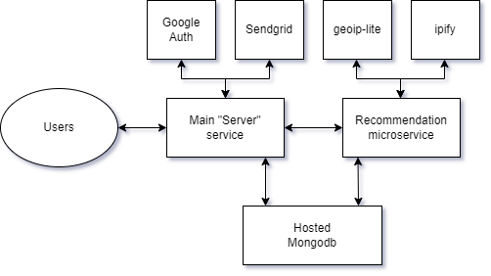
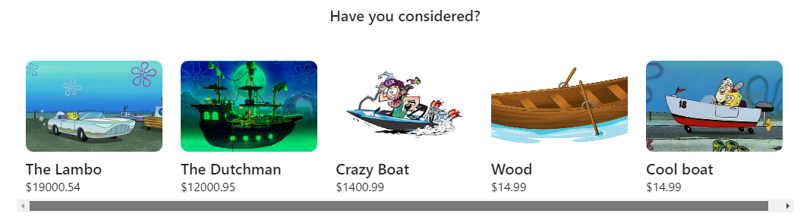
Recommendation Microservice
Listens as its own express server, connecting to the database directly.
Takes a users ip address and finds out what country it is from, then finds out the local gdp per capita of the country to sort recommendations from high to low, or low to high

Slide 10
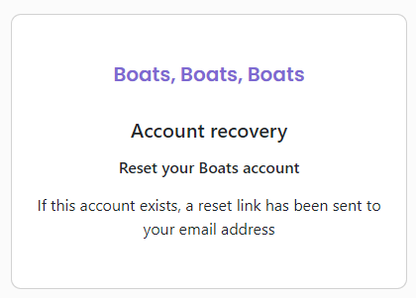
Password Reset - Frontend
Privacy considerations were featured in the Password Reset process.
We were careful to not include any error messages that infer that an email is or isn’t registered on the website.
Sends an email via Sendgrid that contains a password reset link with a reset code parameter.
Front-end allows a new password to be entered and sends it to the back-end.

Slide 11
Password Reset - Backend
-Single use token created for a reset link and stored in resets DB for limited time
-Send via email
-Once link clicked user can reset password once

Slide 12
Demo Time!

